Slide 1
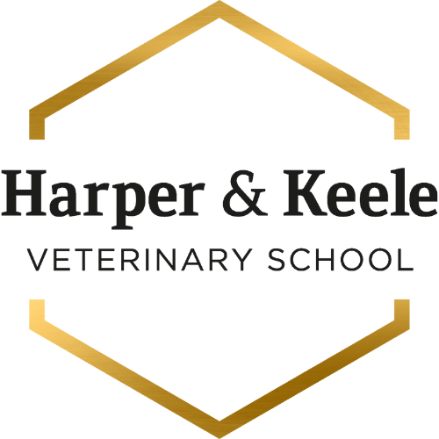
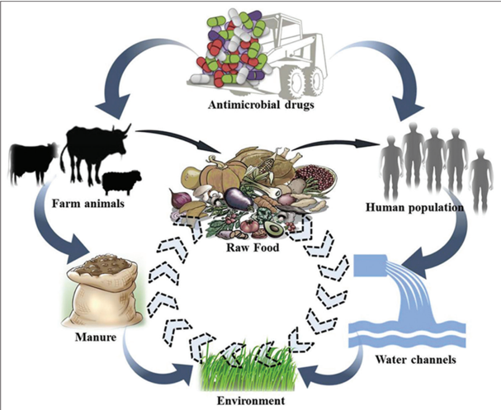

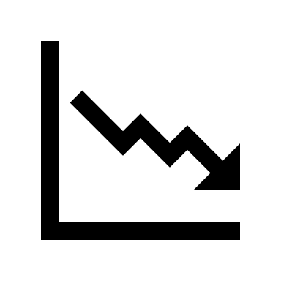
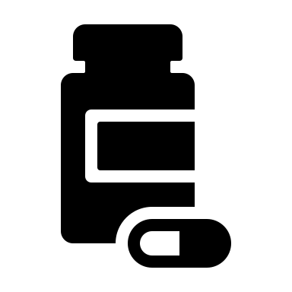
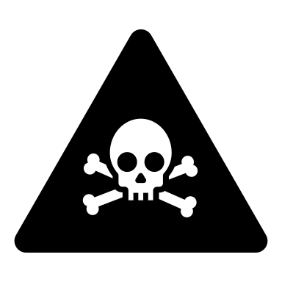

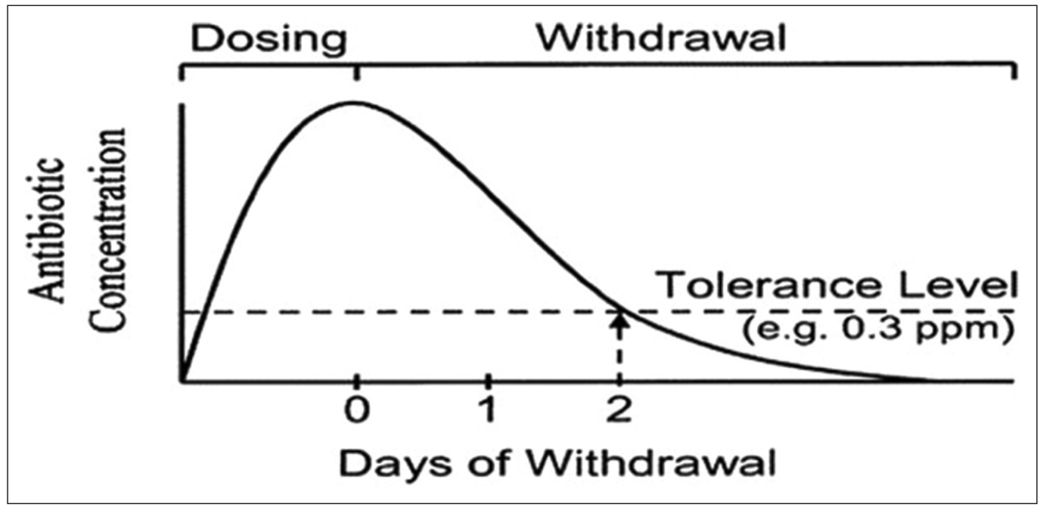
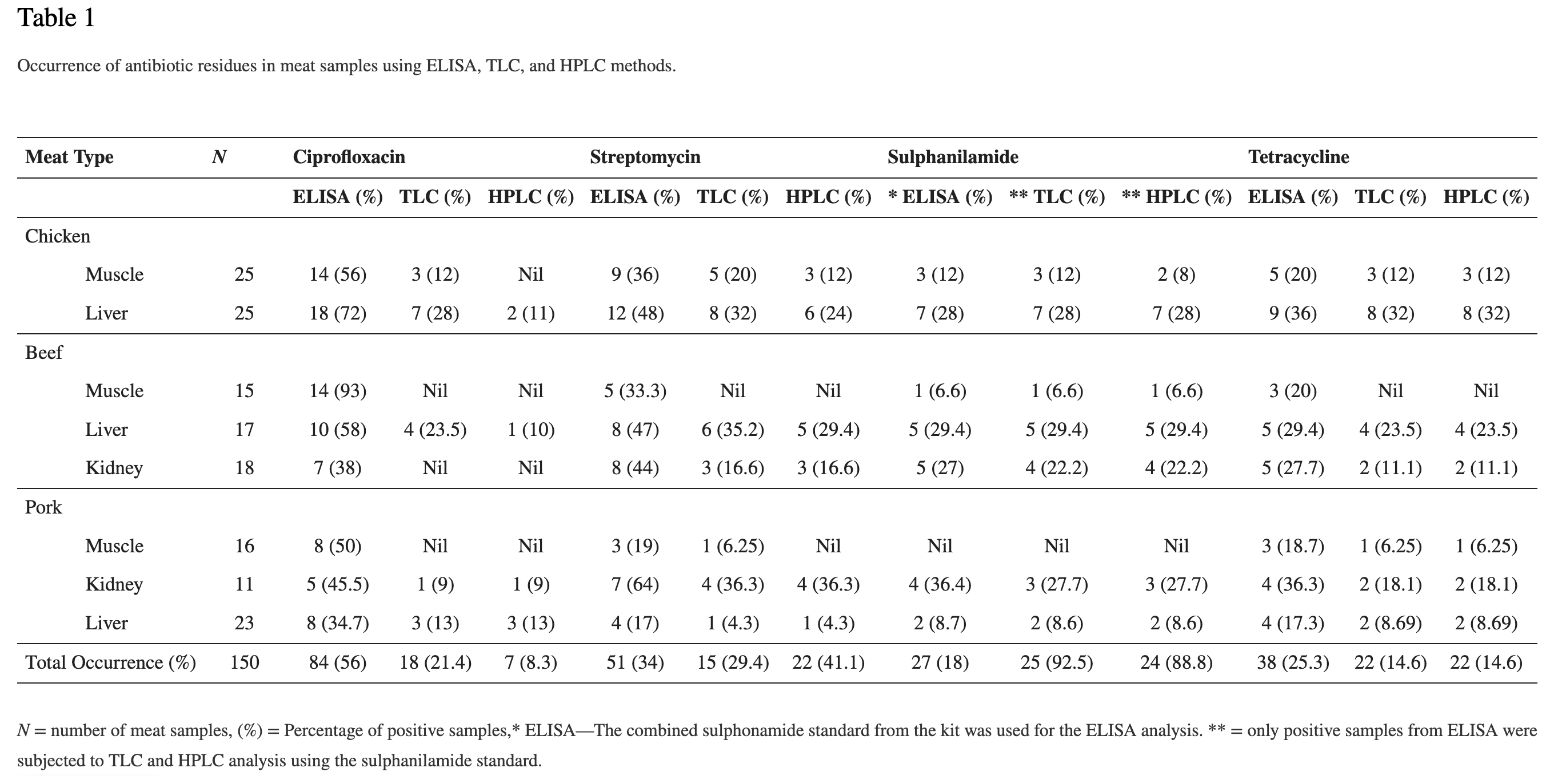
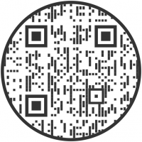


The Role of the Vet in Reducing Medicinal Residue in Meat Products
Aisling Hendron, VET-20003 and Animal Health Sciences
Veterinary Medicinal Residue:
“The parent compounds and/or their metabolites in any edible portion of the animal product, and the residues of associated impurities of a veterinary drug^{”1}
Negative Effect: | Link to consumption of residue:
Carcinogenicity | Residue creates covalent bonds with DNA, RNA, and other intracellular components, increasing the risk of cancerous mutation⁵.
Antibiotic resistance | Exposure to low doses of antibiotics, residual in meat products, increases the likelihood of bacterial adaptation, causing drug-resistant pathogens in both humans and livestock⁷.
Congenital defects | Foetal malformations have been reported to be caused by residual toxic metabolites of veterinary drugs⁵.
Hypersensitivity reactions | Consumption of meat containing a residual drug which is an allergen (e.g.: penicillin) can result in reactions ranging in severity from a skin rash to severe anaphylaxis.
Damage to intestinal flora | Wide-spectrum antibiotics cause gastrointestinal disorders due to disturbance to vital micro-organism populations within intestinal flora⁷.
Negligence Resulting in Residue
Infringement of withdrawal periods
Failure to adhere to label²
Dosing and measurement errors
Multiple doses administered to one site³
Drug contaminated equipment
Use of prohibited drugs⁴
Broad and consistent use
Failure to record treatment⁵
Figure 1: a flowchart showing movement of residual antibiotics⁷
The Associated Legislation
The Animals and Animal Products (Examination for Residues and Maximum Residue Limits) Regulations 2015⁸ were established to protect the consumer against potentially hazardous levels of medicinal residues in animal-derived products⁹.
Reducing Residue Farm Management :
Reducing Residue through Prescription:
Reducing the need for medication consequently reduces the frequency of medicinal residues¹²
A vet’s role is to advise how this can be achieved through farm management, a preventative approach³.
The provision of hygienic conditions and quality feed lowers the risk of disease through the removal of potential pathogens and increase in animal body condition score¹⁰
This also reduces the amount of stress the animal is under⁶, resulting in lower cortisol levels; immune function is therefore supported, reducing the requirement for veterinary intervention.
Vets can also advocate for the breeding of disease resistant livestock⁵.
80%
Vets can reduce residue by ensuring the correct drug is given at the correct dose at the correct time⁹.
It is very important to establish constructive vet-client relationships to ensure prescription drugs are used correctly³.
Many veterinary antibiotics are used only as growth promotors⁶, causing an increasing number of contaminating, resistant bacteria¹².
Vets must prioritise proper drug use, avoiding unapproved or illegal drugs⁴ .
of livestock are administered antibiotics⁴
50%
of medications are
incorrectly prescribed²
80%
of antibiotics are used as growth promoters⁶
They must also responsibly prescribe using the prescribing cascade when no species-specific or veterinary drug is available³ to prevent unregulated residues entering the food chain.
Reduction in disease
Less medicine used
Reduce in residue
Lower public health impact
Vets have a Central Role in the Prevention of Contamination
Farm-to-fork continuum⁵
Training and knowledge in both animal health and food hygiene¹⁰
Current knowledge on methods of prevention⁴
Reducing Residue through Education:
Identifying and Condemning Residue :
Withdrawal period: “The period of time regulatory authorities have set between giving the animal its last dose of veterinary medicine, and it, or its food products, being allowed into the food chain¹³.”
Official Veterinarian (OV): “the term used to describe private practice veterinarians who perform work on behalf of an EU member state of a statutory nature¹⁴.”
A vets’ duty to educate livestock producers on the risks of improper drug use² extends to the risks of extra-label use; effects of disease status; and disregarding withdrawaltime¹². Withdrawal time is calculated using the maximum residue limit and acceptable daily intake³; this must be utilised to minimize non-compliant levels of residue⁴. It is also important for vets
Official veterinarians (OVs) play a crucial role in abattoirs to prevent contaminated meat from entering the food chain⁹. Vets work as part of an interprofessional team, but retain ultimate responsibility for insuring food suitability for human consumption. They also ensure animal identification and traceability, if found to be contaminated¹⁵. OV’s main role within an abattoir is to oversee the antemortem and post-mortem checks¹⁰; this is critical to the
to highlight the danger of
irrational use and mass
medication; this is especially
dangerous in antibiotics as it
contributes to antimicrobial
resistance due to sub-
therapeutic exposure⁶.
process of identifying and removing biological hazards⁹. OV’s also oversee drug and chemical tests¹², which include:
1) Immunological
2) Microbiological
3) Biosensors²
Figure 3: table of antibiotic residue tests’ results¹¹
Figure 2: An example withdrawal graph⁷
References:

